Slide 1
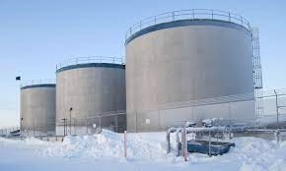
ADAC Project Update
Arctic Facilities and Infrastructure Environmental Change Risk Index (ERI)
Dr. Craig Tweedie, University of Texas El Paso
Dr. Matt Calhoun, University of Alaska Anchorage

Slide 2
Core Research Team
Project Investigators:
Dr. Craig Tweedie, University of Texas El Paso
Dr. Matt Calhoun, University of Alaska Anchorage
Project Supporting Researchers:
Dr. Ben Jones, Institute of Northern Engineering, University of Alaska Fairbanks, Fairbanks AK.
Ms. Kelsey Frazier, ADAC Research Associate, UAA.
Mr. Jeff Libby, Director, Applied Environmental Research Center (AERC), UAA
Dr. Molly Grear, Pacific NW National Laboratories, Sequim, WA. (TBC)
Mr. Nagruk Harcharek, Ukpeaġvik Iñupiat Corporation, Utqiaġvik, AK.
Project Advisors:
Tom Douglas, Cold Regions Research and Engineering Laboratory, Ft Wainwright AK.
Givey Kochanowski, Alaska Senior Advisor for the U.S. Department of Energy (DOE) Office of Indian Energy, Anchorage, AK.

Slide 3
Project Focus
Alaskan USCG-regulated (under 33CFR154) bulk oil facilities and associated infrastructure that persist on permafrost coastal/riverine landscapes that are susceptible to environmental change, namely:
  bulk oil/fuel facilities and/or piers,
  platforms,
  pipelines and
  loading docks near coastal regions or nearby/adjacent waterways.
Facilities/infrastructure may be horizontal or vertically constructed.
Fuel storage facility in Shaktoolik, Alaska, a USCG regulated facility.
Notes:
-Get number of these from proposal
-all loading docks or those just for fuel
-airports?
-is port of nome a facility – check pic
-add caption for 3 main facilities

Slide 4
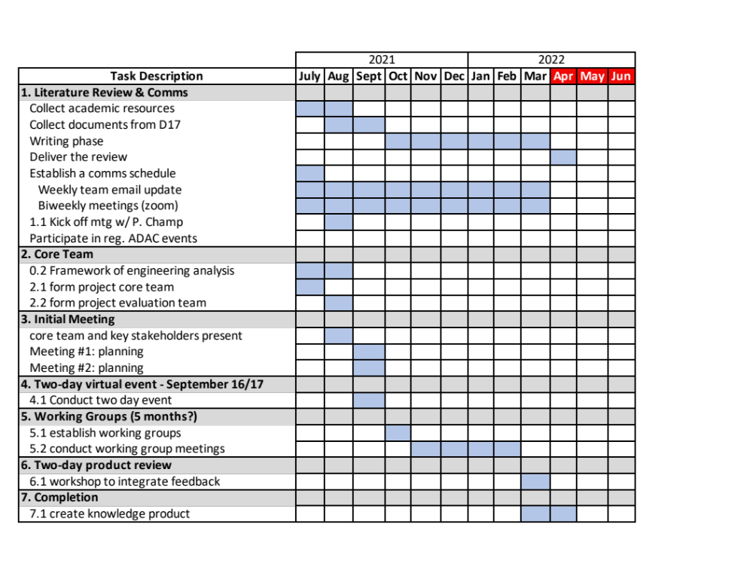
Phase 0: Initiate investigative team led engineering analysis that forms the core of the knowledge product.
Original target date: 1 Apr 2021-15 May 2022
  Milestone 0.1: Program Establishment
  Milestone 0.2: Initiation and onward conduct of engineering analysis.
Final CAPO approval came 8 Jun 2021
Project team has accomplished the following:
  Kickoff meeting
  Weekly core team meetings
  Establishment of team document outlining collected data including an engineering analysis of available data
  Monthly comms with Project Champion

Slide 5
Phase 1: Conduct a comprehensive literature review and establish a communications schedule
Milestone 1.1: Kick-off meeting with HQ USCG Project Champion
  Meeting held 13 April 2021
Milestone 1.2: Identify asynchronous and synchronous instructional tools
  Using Zoom/Teams to conduct video conference calls
  Synchronous options delayed due to covid restrictions
Milestone 1.3: Establish a communications schedule:
  The team hosts a weekly video call to discuss project achievements, questions, and individual assignments
  This call runs roughly 1 hour each Thursday at 9:30 am
  Project PIs participate in weekly ADAC “All Hands” calls
Notes:
-edit ageing infrastructure
-add appropriate pic
-

Slide 6
Phase 1: Conduct a comprehensive literature review and establish a communications schedule
Literature Review:
  Team is utilizing google docs to write the literature review
  Sources include Denali Commission, Alaska Energy Authority, US Army Corps of Engineers, CRREL, Sector Anchorage, as well as academic publications on the fundamental science
Notes:
-edit ageing infrastructure
-add appropriate pic
-

Slide 7
Phase 2: Formation of Project Core Advisory Team and establishment of Project Evaluation Team
Project Core Advisory Team:
  At this stage, the core team is developing the contacts to form an Advisory team. The likely outcome of the 2-day workshop is an expanded pool of potential advisors
Project Core Team:
  The core team consists of the supporting researchers and project PIs who are doing the day-to-day analysis
Project Evaluation Team:
  Team has met with Dr. Nancy Kinner who will lead the Evaluation Team
  Mid-project review in December 2021
Notes:
-edit ageing infrastructure
-add appropriate pic
-

Slide 8
Phase 3: Initial meetings … initiate group efforts to investigate principal and supporting research questions
Milestone 3.1 Conduct first meeting of core team
  Delayed: core team to come after workshop
Milestone 3.2 Conduct second meeting of core team
  Delayed: core team to come after workshop
Notes:
-edit ageing infrastructure
-add appropriate pic
-

Slide 9
Phase 4: Conduct two-day virtual event
Date: 29 & 30 September 2021
  Changed due to folks out in field work; needed some additional time
  65+ participants attended virtually
  Focused team on key factors and indices
  Takeaways for observations that indicate challenges
Day 2 was closed door with USCG input
  Critical feedback included method for delivering the risk index
  Static index with future potential for dynamic index
  Categorical factors for coastal erosion, flooding, permafrost thawing.
  Many discussions around maintenance challenges
  Index as a point of community collaboration & discussion
Notes:
-edit ageing infrastructure
-add appropriate pic
-

Slide 10
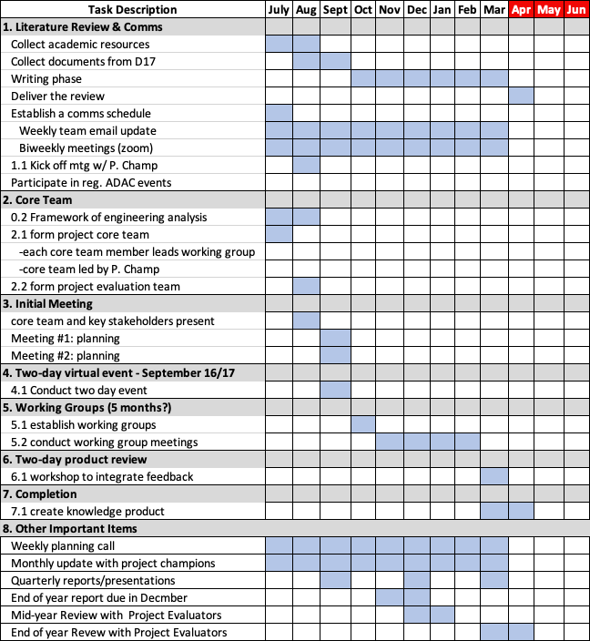
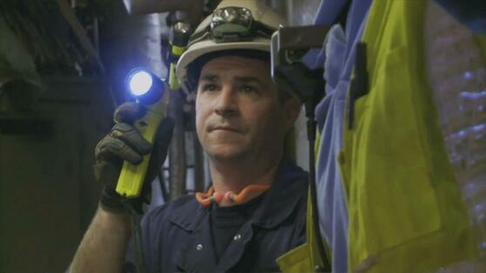
Ready for comments
https://www.marinedefenders.org/coast-guard-inspection.html

